Slide 1
Nursing and Midwifery Job Profiles
Launch briefing for Clinical Groups and Corporate Group

Slide 2
Programme Overview
The Trust is embarking on a programme of work to align all Nursing and Midwifery job descriptions (Bands 4–9) to newly published national job profiles and ensure fair, consistent application of the NHS Job Evaluation Scheme (JES).
This work responds to a national requirement following the 2023 Agenda for Change pay deal and aims to ensure that roles are accurately described, consistently evaluated, and appropriately banded every 3 years.
It will build on work already completed through OneMFT with review roles at Bands 8a-9
NHS Employers and NHS Staff Council Job Evaluation Group have provided guidance but responsibility for implementation has been devolved to individual organisations.
Executive responsible officers at MFT are Kimberley Salmon-Jamieson, CNO and Meera Nair, CPO and we are required to provide quarterly data reports to NHSE.
The Corporate Nursing and Midwifery Workforce Team and Corporate Workforce team are running this programme in partnership with Staff-side colleagues.

Slide 3
Background
2021:
The NHS Staff Council asked the national Job Evaluation Group to undertake a full review of the national job matching profiles for nursing and midwifery.
2023:
The 2023 Agenda for Change (AfC) pay deal included a commitment to identify ways to support the fair and consistent application of the NHS Job Evaluation Scheme (JES).
23 April 2025:
The Secretary of State for Health and Social Care made a Statement to Parliament stating the government would take forward the recommendation in the 2023 AfC Deal relating to improving local job evaluation practice.
June 2025:
Revised suite of N&M Job Profiles published.
October 2025:
New suite of JD/PS for bands 8a-9 following OneMFT
11th February 2026:
The Government announced a commitment to reviewing the roles and pay bands of every Band 5 nurse
1st April 2026:
Annex 31 has been added to the NHS Terms and Conditions of Service handbook following the outcome of 2023 non-pay deal recommendations to provide clarity and support the application of the Job Evaluation Scheme.

Slide 4
Programme aims
The programme will:
Improve accuracy and consistency of job descriptions
Support fair pay for work of equal value
Strengthen governance and reduce organisational risk
Create a sustainable, standardised approach to maintaining JDs

Slide 5
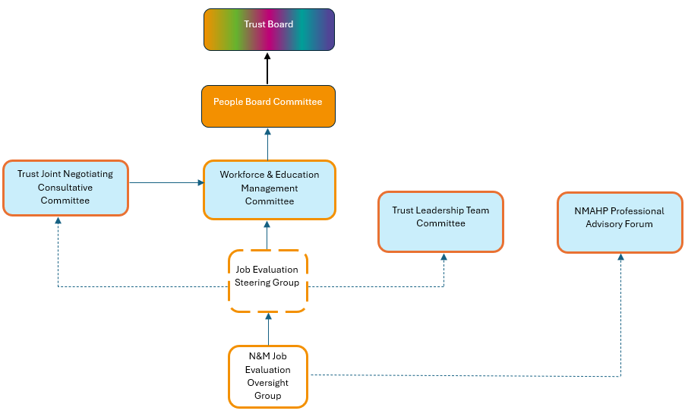
Governance

Slide 6
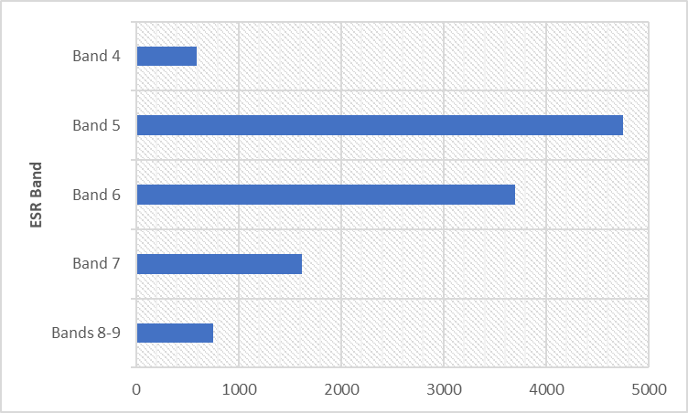
Scale of task
Clinical Group | Headcount
CSS | 1103
LCOD | 1433
MRI | 1866
NMGH | 941
SPEC | 3311
SPEC (REH) | 189
SPEC (RMCH) | 1322
SPEC (SMH Maternity) | 1064
SPEC (SMH Nursing) | 736
WTWA | 2293
R&I | 256
CORP | 208
Grand Total | 11411
There are 11,400 Nurses and Midwives in scope.

Slide 7
Challenges
Central Repository only includes those JDs that have been through job evaluation.
Limited JE Activity - only 65 JDs undergone formal job evaluation in the last 3 years from a potential of 100s that have been identified.
Managers have often sourced and amended JDs independently, which means they have not gone through the formal job evaluation process.
The potential of different JDs for the same roles could lead to inconsistencies and expose the organisation to equal pay claims.
JDs are currently not mapped to individuals or posts within ESR.

Slide 8
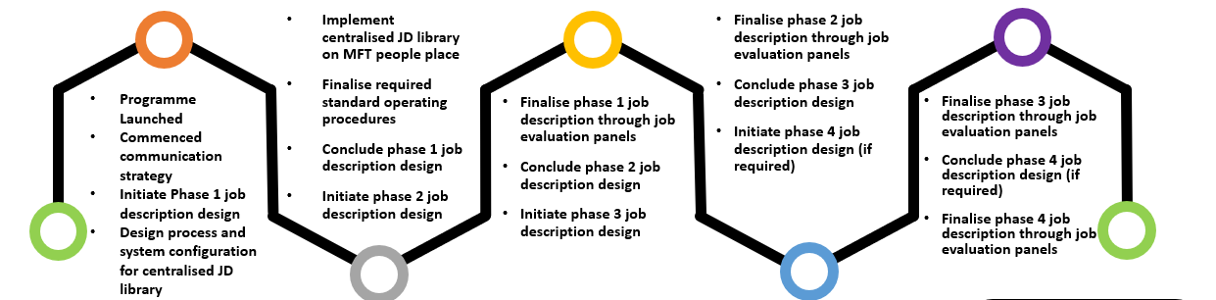
Programme plan
6 – 9 months
6 – 9 months
Phase 1 - Band 4 & 5 and Health Visitors
Phase 2 – Ward/Team/Department based Band 6 and Band 7 and 8a-9 excluded from OneMFT phase 3
Phase 3 – Non-ward/Specialist Band 6 - 8c

Slide 9
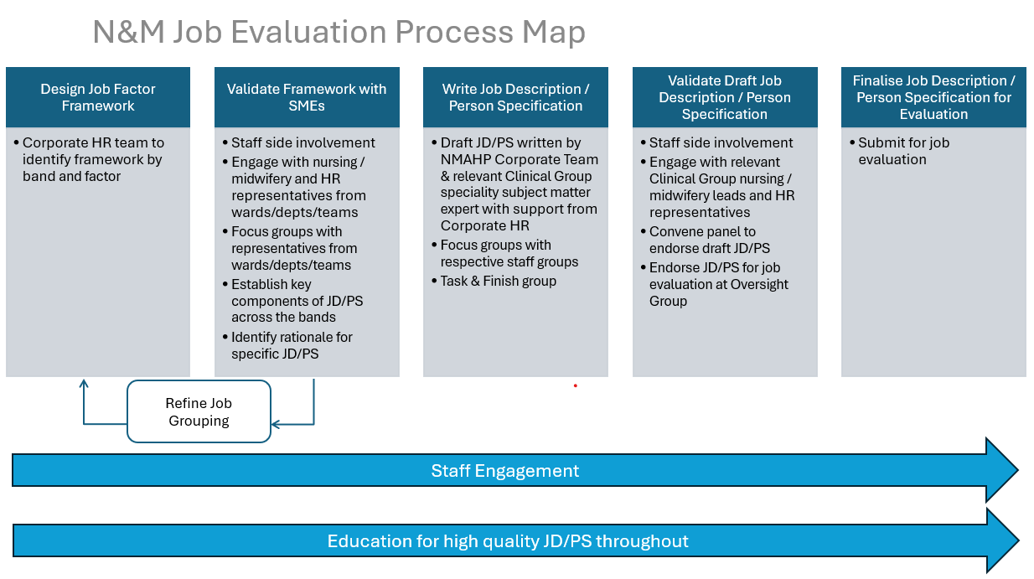
Creating a Job Description

Slide 10
Band 4 to 9 progression focus groups
Define how to describe the differences as colleagues progress through the bandings from 4 to 9
Focus group 1
Focus Group 2
Focus Group 3
Sample of N&M colleagues in relevant bandings for each of the job groupings at each focus group
Start with providing an understanding of what a JD is and principles for writing one using language consistent with the job profiles
Table work for each job grouping to include role specific detail
Framework for progression from band 4 to 9

Slide 11
JD/PS development focus groups
Focus Group A
Focus Group B
Focus Group C
Focus Group D
Focus Group E
Focus Group F
Co-design draft job descriptions based on what colleagues do
Based across MFT sites to ensure accessibility for colleagues
Sample of N&M colleagues in relevant bandings for each of the job groupings at each focus group
Start with providing an understanding of what a JD / PS is and principles for writing one using language consistent with the job profiles
Table work for each job grouping to include role specific detail
Draft JD / PS

Slide 12
What we need from you
Be engaged with all aspects of the programme as coordinated by the Oversight Group
Support local communication and manage expectations
Provide consistent, accurate messages and to seek advice if not aware of the answers
Support colleagues with time off to attend all relevant focus groups and to be fully involved in the process
Work with the oversight group members in the creation of JD/PS
Release JE trained colleagues to support JE process
Provide honest feedback

Slide 13
Key contacts
Mark Keegan, Director of Nursing – Workforce and Education
Alison Hughes, Head of Specialist HR Services
Sue Britland-Jones, Senior HR Business Partner – Corporate
Kevin Hurst, Head of Nursing – Workforce and Education
Marie Mathew, Lead Nurse – Corporate NMAHP Workforce Team
Jonathan Lenton, Workforce Project Lead

